Slide 1

DVD Store
Movies and Rental
Notes:
To change the image on this slide, select the picture and delete it. Then click the Pictures icon in the placeholder to insert your own image.

Slide 2
Languages present and Count of movies in each language
Language present:
English
Italian
Japanese
Mandarin
French
German
Language in which Movies are made: English
Count of movies made: 1000

Slide 3
Count of movies based on category

Slide 4
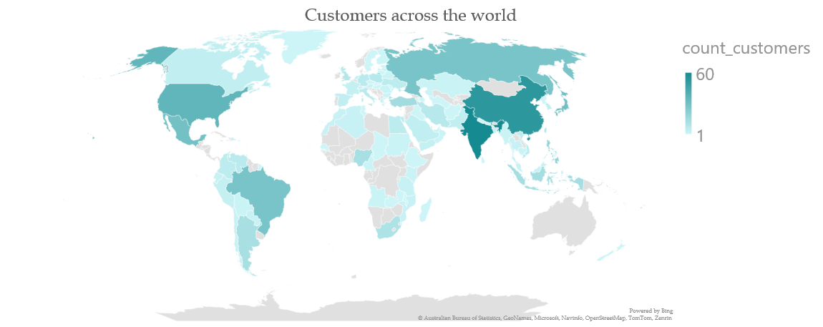
Customers across the world

Slide 5
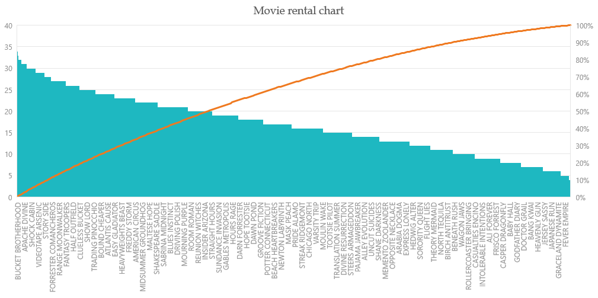
Movie rental chart

Slide 6
Movie rental based on type

Slide 7
Number of movies by actor

Slide 8
Sum of rental cost by category

Slide 9
Total rental cost by movie

Slide 10
Thank You

